Slide 1

Fundamentals of Storage and Data Center Module Number: 01
Module Name: Introduction to Storage and Data Centers Information Storage

Slide 2
Introduction to Storage and Data Centers Information Storage
AIM
To equip students with fundamentals of storage and overview of data centers.

Slide 3
Introduction to Storage and Data Centers Information Storage
Objectives of This Module
The Objectives of this module are:
Basic understanding of data, information and storage.
To explain the evolution of storage technology.
Understand the basics of data center.

Slide 4
Introduction to Storage and Data Centers Information Storage
Outcome
At the end of this module, you are expected to:
Understand what is data and its types.
Differentiate between data and information.
Understand how storage technology evolved over time.
Understand the lifecycle of information and its management.
Acquire basic overview of data centers.

Slide 5
Introduction to Storage and Data Centers Information Storage
Contents
Introduction to data and its types
Data and Information
Information Storage
Evolution of Storage Technology
Information Lifecycle and ILM
Introduction to Data Center
Role of Data Center in the Enterprise
Role of Data Center in Service Provider Environment
Data Center Architecture

Slide 6
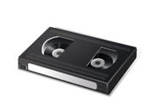



Introduction to Storage and Data Centers Information Storage
Do you have any idea about what is data?
Most data is being converted into a digital format
Driven by user demand
Facilitated by
Increase in data processing capabilities
New and cheaper peripherals
Lower cost and increased speed of storage
Affordable and faster networks
Who creates data?
Individuals
Businesses
“Collection of raw facts from which conclusions may be drawn”
Video
01010101010
Photo
10101011010
00010101011
01010101010
Book
10101010101
01010101010
Letter
Digital Data
Notes:
Data:
Data is the raw and unorganized fact.
It can be numbers, characters, text, sound, pictures, video, and figure that is not processed or put into context

Slide 7
Introduction to Storage and Data Centers Information Storage
How many categories of data are there?
Data can be categorized into following categories:
Structured:
Data Bases
Spread Sheets
Unstructured:
Instant messages
Images
Audio
Video
Movies
Over 80% of enterprise data is unstructured
E-Mail Attachments
X-Rays
Unstructured (80%)
Manuals
Instant Messages
Images
Documents
Web Pages
Rich Media
Audio Video
Structured (20%)
Notes:
The classification of data is based on the way it is stored and managed. The types of data:
Structured: It is very commonplace and often managed using Structured Query Language (SQL). It is the most processed in development and the simplest way to manage information. However, structured data represents only 10% to 20% of all informatics data. It has the advantage of being easily entered, stored, and queried. Examples are Global Positioning System (GPS), medical devices, smart meters, data from networks, biometric devices, and stock trading data, phone numbers (and the phone book), census records (birth, income, employment, place).
Unstructured: Unstructured data includes data that is not classified and organized. It represents around 80% of data available in the world. It often includes text and multimedia content. E-mail messages, range of documents, Web Pages, audio files, photos, videos, presentations, and many other types of business artefacts are examples of unstructured data. This type of data is internally structured, however, it is still considered unstructured because it does not fit in rows and columns of a database. Data generated by users on social media platforms such as YouTube, Facebook, Twitter, LinkedIn, blogs, and forums are all unstructured data.

Slide 8

Introduction to Storage and Data Centers Information Storage
How data differs from information?
Data: Collection of raw facts from which the required output is extracted.
Information: Intelligence and knowledge derived from data.
Notes:
Data is a collection of raw facts from which the required output is extracted. A paper document, photograph, a movie on a disk, a message, a bank account holder’s passbooks, buyer and seller agreements, and papers of property are all examples of data.
Information is the intelligence and knowledge that is derived from data. It is classified data which has some intrinsic value for the receiver. Businesses analyse raw data in order to identify meaningful trends on which decisions and actions are made.
Icon Source: Internet

Slide 9
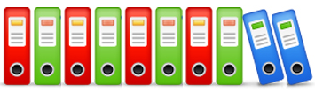
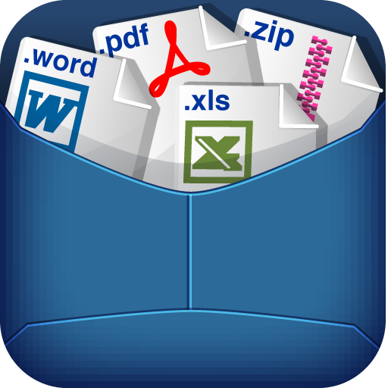

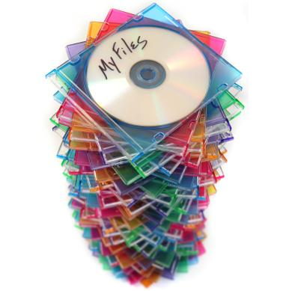
Introduction to Storage and Data Centers Information Storage
Information Storage
Collects and arranges data
Acts as an Information repository
Examples:
Notes:
Series of processes executed in an organized way to collect and arrange data
Repository of information enabling users to store, protect, retrieve as required
Facilitates in making data easily accessible for further processing
Storage type depends on type and usage frequency of information
Businesses typically use internal hard disks, tapes, and external disk arrays to store data.
Devices such as hard disks in personal computers, DVDs, CD-ROMs, and memory in a cell phone or digital camera are examples of information storage devices
Icon Source: Internet

Slide 10
Introduction to Storage and Data Centers Information Storage
Why Information Storage ?
“Digital universe – The Information Explosion”
21st Century is information era
Information is being created at ever increasing rate
Information has become critical for success
We live in an on-command, on-demand world
Example: Social networking sites, e-mails, video and photo sharing website, online shopping, search engines etc.
Information management is a big challenge
Organization seek to Store Protect Optimize Leverage the information optimally
Can you imagine how much facebook data is generated daily ???
Notes:
The growth of information has been exponential over the years. Managing this explosive growth of information is the biggest challenge of the day

Slide 11
Introduction to Storage and Data Centers Information Storage
Evolution of Storage Technology
Storage technology has evolved through the following configurations:
Direct Attached Storage (DAS)
Redundant Array of Independent Disks (RAID)
Network Attached Storage (NAS)/Storage Area Network (SAN)
Internet Protocol SAN (IP-SAN)
Notes:
Direct-Attached Storage (DAS) – This kind of storage connects directly to a computer or a group of servers.
Redundant Array of Independent Disks (RAID) – The term RAID was originally defined as redundant array of inexpensive disks and now it refers to redundant array of independent disks. This type of storage was developed to address the cost, fault tolerance, and performance, and increase storage capacity in a system.
Storage Area Network (SAN) – This is a high-speed network of storage devices. It also links those storage devices with servers. Storage is segregated and assigned to a server for accessing its data.
Network-Attached Storage (NAS) – An NAS device is a storage device connected to a network that allows storage and retrieval of data from a centralized location. It is mainly required for file sharing.
Internet Protocol SAN (IP-SAN) – IP was developed as an open standard with a complete design of components. The storage protocols designed to shift block-based data between a host server and storage array include the Fibre Channel over IP (FCIP), Internet Fibre Channel Protocol (iFCP), and Internet Small Computer Systems Interface (iSCSI). The most common type of IP SAN uses iSCSI to summarize SCSI commands and assemble data into packets for transfer between the storage devices and host servers. One of the latest evolutions in storage architecture, IP-SAN is a merging of technologies used in SAN and NAS.

Slide 12
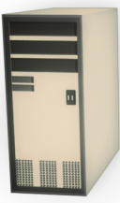

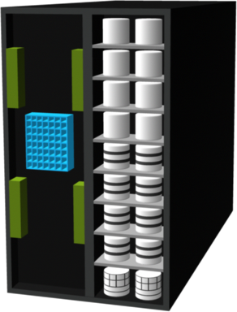
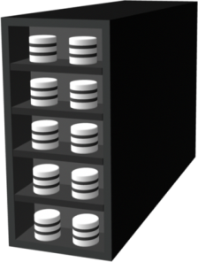
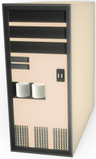
Introduction to Storage and Data Centers Information Storage
Multi Protocol
Router
LAN
FC SAN
Fibre Channel (FC)
IP SAN
SAN / NAS
RAID Array
Internal DAS

Slide 13
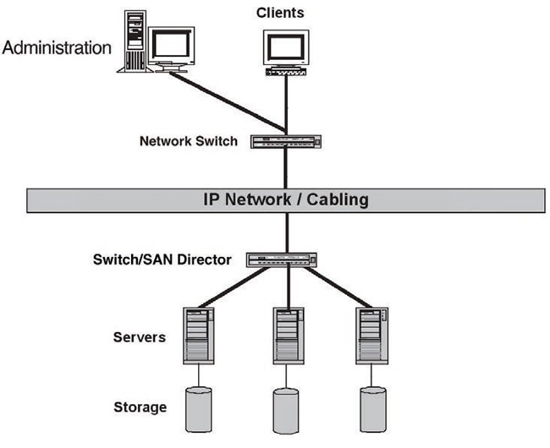
Introduction to Storage and Data Centers Information Storage
Direct Attached Storage
Notes:
Direct Attached Storage (DAS)
Connects directly to computer or group of servers
Storage can be either internal or external to server
Example: Internal hard drive in a computer

Slide 14
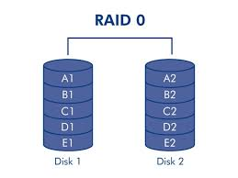
Introduction to Storage and Data Centers Information Storage
Redundant Array of Independent Disks
Notes:
Redundant Array of Independent Disks (RAID)
Developed to address the cost, fault tolerance, and performance
Used in all storage architectures such as DAS, SAN
Combine multiple paces and disk drives into an array to achieve redundancy

Slide 15
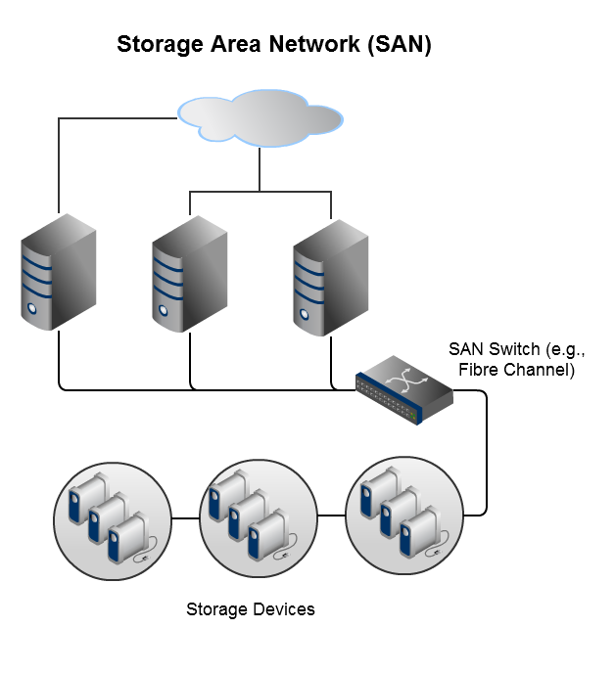
Introduction to Storage and Data Centers Information Storage
Storage Area Network
Notes:
Storage Area Network (SAN)
High-speed network
Links storage devices with servers
Offers block-level storage
Helpful in disaster recovery and backup settings
Utilize networking protocols or Fibre Channel technology

Slide 16
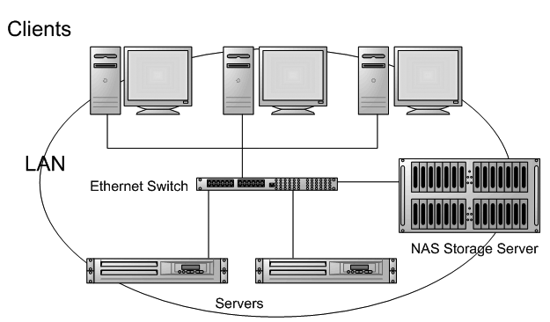
Introduction to Storage and Data Centers Information Storage
Network Attached Storage
Notes:
Network Attached Storage (NAS)
Allows storage and retrieval of data from a centralized location
Required mainly for file sharing
Simple to operate, safe, and reliable
Does not provide e-mail, authentication, or file management tasks
Can exist anywhere in a LAN

Slide 17
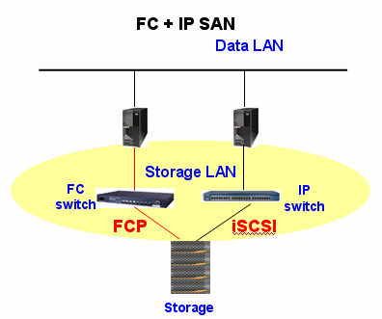
Introduction to Storage and Data Centers Information Storage
IP-SAN
Fibre Channel (FC)
Notes:
Internet Protocol SAN (IP-SAN)
Merging of technologies used in SAN and NAS
Developed as an open standard with a complete design of components
Include FCIP, iFCP, and iSCSI

Slide 18
Introduction to Storage and Data Centers Information Storage
Self Assessment Questions
Which of the given options is true about data?
Raw fact
Processed fact
Processed information
None of the Above
Answer: a)
Notes:
1. a)

Slide 19
Introduction to Storage and Data Centers Information Storage
2. Which of these is not an example of unstructured data?
Images
Videos
Audio
Spreadsheet
Answer: d)
Notes:
2. d)

Slide 20
Introduction to Storage and Data Centers Information Storage
Document Links
Topics | URL | Notes
Storage Management | https://www.techopedia.com/definition/30481/storage-management | This link explains about basic concept of storage management
Concept of Data and Information | http://www.differencebetween.info/difference-between-data-and-information | You will learn in details how data differs from information. This link provides a tabular comparison between data and information
Storage Technology Evolution | http://www.siemon.com/us/white_papers/14-07-29-data-center-storage-evolution.asp | This link explains about how storage technology has evolved over the years

Slide 21
Introduction to Storage and Data Centers Information Storage
Video Links
Topics | URL | Notes
Overview of data and information | https://www.youtube.com/watch?v=mUgEgkV16Bw | This video explains about data and information and their relation
Types of data | https://www.youtube.com/watch?v=WBU7sW1jy2o | A detailed description about types of data is presented in this video with enough real-life examples

Slide 22
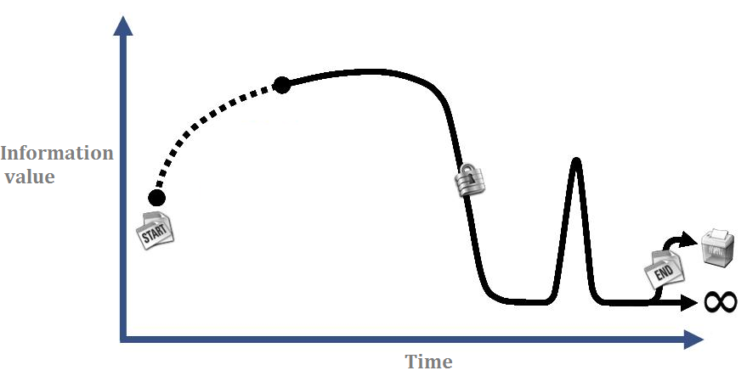
Introduction to Storage and Data Centers Information Storage
Information Lifecycle
Change in the value of information with time, from its creation until disposal
Notes:
As time passes by, the value of information changes. The piece of information that was more valuable yesterday becomes of lesser importance today. This change in the value of information with the course of time can be understood as information lifecycle.
Icon Source: Internet

Slide 23
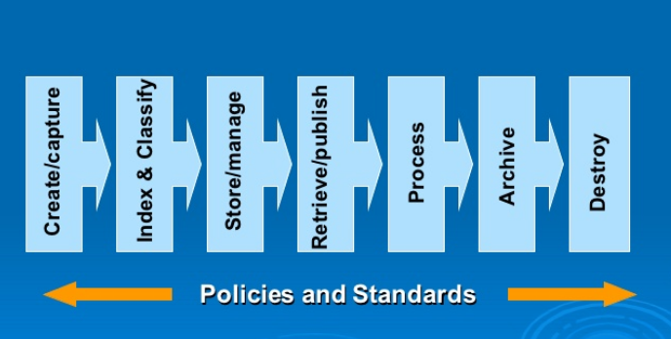
Introduction to Storage and Data Centers Information Storage
Stages in Information Lifecycle
Notes:
Information gets created or collected, followed by proper indexing and classification. Properly stored information is retrieved and published or distributed on need basis. Some information might be required in the long run and hence, is archived for future use. However, some pieces of information are created for a finite purpose and once the purpose is solved, they can be discarded or removed.

Slide 24
Introduction to Storage and Data Centers Information Storage
Information Lifecycle Management (ILM)
ILM refers to the creation and management of wide-ranging set of strategies for streamlining the storage infrastructure and the data within it. It is a comprehensive approach in managing the flow of data from its creation to its disposal.
Notes:
ILM is the process of managing information throughout its lifecycle. (i.e. from the time information is created till the time information is destroyed)

Slide 25
Introduction to Storage and Data Centers Information Storage
Information Lifecycle Management (ILM) Example
Protect
New
Process
Deliver
Warranty
order
order
order
claim
Time
Value
Fulfilled
Aged
Warranty
order
data
Voided
Create
Access
Migrate
Archive
Dispose
Notes:
An example proactive strategy that enables an IT organization to effectively manage the data throughout its lifecycle

Slide 26
Introduction to Storage and Data Centers Information Storage
Information Lifecycle Management (ILM) Process Overview
AUTOMATED
Classify data / applications based on business rules
Implement policies with information management tools
Organize storage resources to align with data classes
Integrated management
of storage environment
FLEXIBLE
Notes:
Classify the information and applications based on business rules and policies so that differentiated treatment of information can be enabled.
Implementation of policies using the information management tools, ranging from the creation of data to its disposal.
Integrated Management of the environment by using integrated tools so that the operational complexity can be reduced.
Organisation of storage resources in tiers to appropriately align relevant resources with data classes, and storage of information in the appropriate kind of infrastructure based on information value

Slide 27
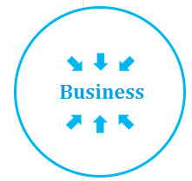

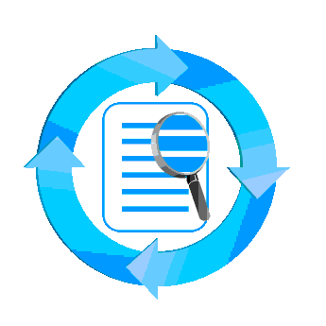

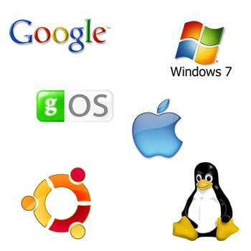
Introduction to Storage and Data Centers Information Storage
Information Lifecycle Management (ILM) Characteristics
ILM should possess the following characteristics to obtain and maintain an ILM strategy:
Business-centric
Policy-based
Optimised
Centrally-managed
Heterogeneous

Slide 28
Introduction to Storage and Data Centers Information Storage
Information Lifecycle Management (ILM) Benefits
Information retrieval is quick
Management is simplified
Compliances and governance is managed
Operations cost is lowered
Utilisation is improved
Provides wide range of options
TCO is lowered
Notes:
ILM is an organization-level process that holds within all the processes and resources contributing to the data flow in the organization. By using ILM, it is actually possible to categorise, evaluate, and locate all through its lifecycle. The ensures the cost-effective and quick retrieval of data any given point in time.

Slide 29
Introduction to Storage and Data Centers Information Storage
How good ILM can be for your organisation?
Improved utilization
Tiered storage platforms
Simplified management
Processes, tools and automation
Simplified backup and recovery
A wider range of options to balance the need for business continuity
Maintaining compliance
Knowledge of what data needs to be protected for what length of time
Lower Total Cost of Ownership
By aligning the infrastructure and management costs with information value

Slide 30
Introduction to Storage and Data Centers Information Storage
Self Assessment Questions
3. The best storage technology for global data sharing is:
SAN
NAS
RAID
IP-SAN
Answer: d)
Notes:
3. d)

Slide 31
Introduction to Storage and Data Centers Information Storage
4. The value of information ______________
Remains constant
Changes over time
May change or may not change over time
None of above
Answer: b)
Notes:
4. b)

Slide 32
Introduction to Storage and Data Centers Information Storage
5. Which of these is not a stage of Information Lifecycle?
Data creation
Data sharing
Data archival
None of the above
Answer: d)
Notes:
5. d)

Slide 33
Introduction to Storage and Data Centers Information Storage
6. DAS is a kind of storage that is directly connected to a computer.
True
False
Answer: a)
Notes:
6. a)

Slide 34
Introduction to Storage and Data Centers Information Storage
INTRODUCTION TO
DATA CENTER

Slide 35
Introduction to Storage and Data Centers Information Storage
What is a data center?
Data centers store and manage a large volume of mission-critical data. Organizations maintain data centers to provide integrated data processing facility across the system.
Notes:
Large organizations frequently maintain more than one data center. This enables them to provide backups in the event of a disaster and distribute data processing workloads. A combination of various storage architectures is used to meet the storage requirements of a data center.
Icon Source: Internet

Slide 36
Introduction to Storage and Data Centers Information Storage
Goals of Data Center
Support for business operations around the clock (resiliency)
Protection of data against disaster and multiple software/hardware failure
Safe custody of huge amount of data
Lowering the total cost of operation and the maintenance needed to sustain the business function
Notes:
Local backups are good and beneficial considering the first step of protection they provide. These are very effective against initial errors such as manual intervention with data, software or hardware failures but these fail when it comes to protection against theft, disaster or multiple software/hardware failure due to voltage. Under these circumstances, data centers are helpful

Slide 37
Introduction to Storage and Data Centers Information Storage
Facilities offered by Data Center
Helps distribute data processing workloads for large organisations.
Combines various storage architectures to meet the storage requirements of organisation
Uninterrupted and seamless operation
Notes:
Because Data Centers house critical computing resources, enterprises must make special arrangements with respect to both the facilities that house the equipment and the personnel required for a 24x7 operation.

Slide 38
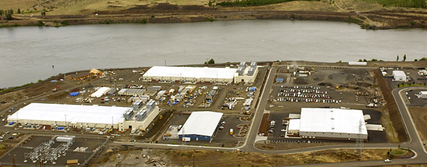
Introduction to Storage and Data Centers Information Storage
How a Data Center look like?
Notes:
The image presents the Google data center, The Dalles Oregon. This is one of the biggest data center in the world

Slide 39
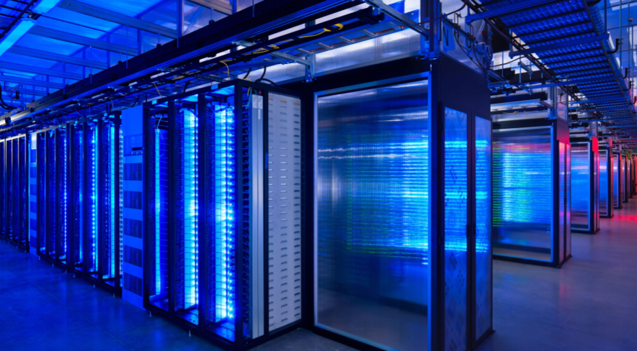
Introduction to Storage and Data Centers Information Storage
Inside of Facebook data center

Slide 40
Introduction to Storage and Data Centers Information Storage
Core Elements in Data Center Infrastructure
Applications
Databases – Database Management System (DBMS) and the physical and logical storage of data
Servers/Operating systems
Networks (LAN and SAN)
Storage arrays
Notes:
Application: This is a computer program which provides the logic for computing operations. Applications can be layered on a database. The database, in turn, can use operating system services to carry out read/write operations to storage devices.
Database: A database management system (DBMS) offers a structured way to store data in logically organized, interconnected tables. A DBMS facilitates the storage and retrieval of data.
Server and operating system: This is a computing platform that runs databases and applications.
Network: This is a data path that enables communication between servers and storage and between customers and servers.
Storage array: This is a device that stores data for consequent use.

Slide 41




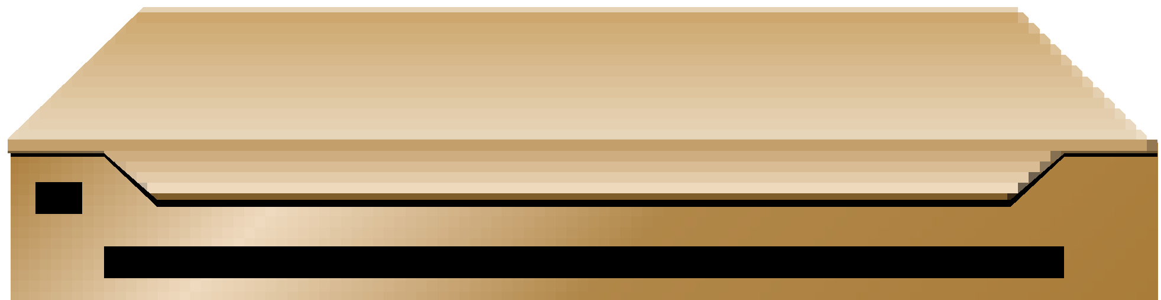
Introduction to Storage and Data Centers Information Storage
Storage Array
Server
Client
Storage Area Network
Local Area
Network
Application User Interface
Database
OS and DBMS
Notes:
This slide identifies the 5 core elements of a data center and how they relate to each other

Slide 42
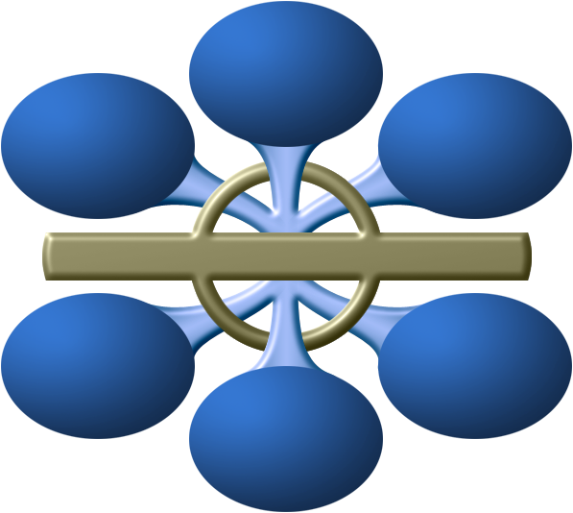
Introduction to Storage and Data Centers Information Storage
What key factors to ensure for the success of a Data Center?
Availability
Data Integrity
Security
Manageability
Performance
Capacity
Scalability

Slide 43
Introduction to Storage and Data Centers Information Storage
Key Requirements for Data Center Elements
Availability
Location and facility
Uptime
Cooling
Security
Facility maintenance
Scalability
Change Management

Slide 44

Introduction to Storage and Data Centers Information Storage
Availability: All data center elements should be designed to enable accessibility. The ability of users to access data when necessary can have a positive impact on a business.
Notes:
Elements should be available on demand. Accessibility of elements can have a great impact on productivity

Slide 45

Introduction to Storage and Data Centers Information Storage
Location and Facility: Location can have a considerable impact and could serve as an opportunity to enhance the company’s ability to address network expectancy, disaster recovery, and data control. When determining the location of a data center, it is also necessary to consider the geographical location with respect to the service provider.
Notes:
Choosing a good location for data center can help to ensure continuous service availability and uptime. Environmental factors to be considered while choosing a site for data center.

Slide 46

Introduction to Storage and Data Centers Information Storage
Uptime: Organizations can lose a lot of money during the downtime due to the inaccessibility of necessary information and resources. The service provider’s track record of uptime should be tested and it should be determined whether the provider has been able to maintain 100% availability for electrical and mechanical systems in the past.
Notes:
It is important to know about prior events related to planned or unplanned downtime and the methods by which these instances were addressed by the service provider.

Slide 47
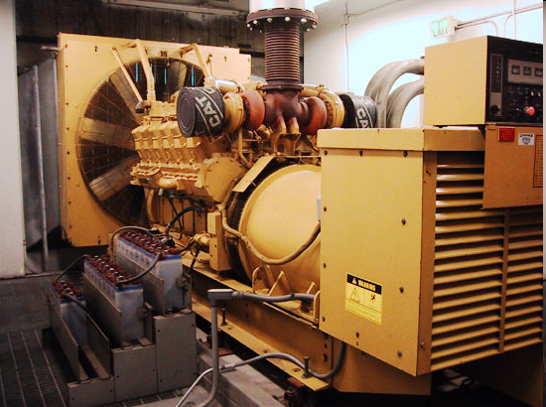
Introduction to Storage and Data Centers Information Storage
Powerful backup arrangement to provide 100% Uptime

Slide 48

Introduction to Storage and Data Centers Information Storage
Key Requirements for Data Center Elements
Cooling: The establishment of a data center involves a combination of utilities, generators, and a range of power supplies that emit excessive heat. It is essential to have a robust cooling infrastructure to ensure cost efficiencies and a viable environment to establish the data center.

Slide 49
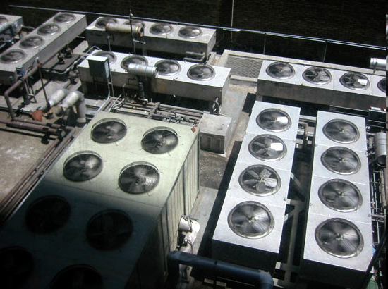
Introduction to Storage and Data Centers Information Storage
Cooling arrangement in data center environment

Slide 50
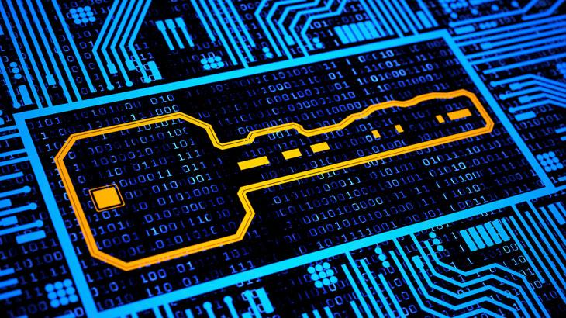
Introduction to Storage and Data Centers Information Storage
Security: The security of the data center is equally important. It is necessary to establish policies and procedures, and ensure proper integration of the data center core elements in order to prevent unauthorized access to information. To maximize protection, the facility should be fabricated with military-grade security measures.
Notes:
Various measures to implement security includes onsite security workforces, and video surveillance and recording especially at the entrances, exits, roof access, and equipment areas.

Slide 51

Introduction to Storage and Data Centers Information Storage
Facility Maintenance: During the installation of a data center, it is important to consider the maintenance and management aspects. The provider should have sufficient insight of the facility and its efficiencies to ensure that the entire system is being observed and any issues can be quickly addressed before they cause any outage.

Slide 52

Introduction to Storage and Data Centers Information Storage
Scalability: Data center operations should be able to allocate additional on-demand storage or processing capabilities, without interrupting business operations. For the growth of a business, it is often necessary to install more servers, additional databases, and new applications. The storage solution should also able to grow with the business.
Notes:
There should be a scope for expansion in every aspects. It is therefore essential to have a suitable sized data center with an ample expansion capacity to increase power, network, physical space, and storage. Established organizations actively track and report on this concept.

Slide 53
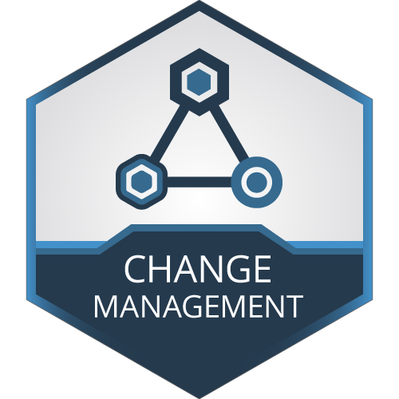
Introduction to Storage and Data Centers Information Storage
Change Management: Proper guidelines for change management ensure that there is no alteration in the data center that has not been planned, scheduled, discussed, and approved. It is also necessary to provide back out steps or a Plan B. Whether bringing new amendments to the system or making old practices obsolete, data centers must follow the change management process.

Slide 54
Introduction to Storage and Data Centers Information Storage
Self Assessment Questions
7. Which of these is a data center element?
Databases
Servers
Applications
All of these
Answer: d)
Notes:
7. d)

Slide 55
Introduction to Storage and Data Centers Information Storage
8. Availability of data center elements refers to _________________ of the elements.
Accessibility
Robustness
Scalability
Optimality
Answer: a)
Notes:
8. a)

Slide 56
Introduction to Storage and Data Centers Information Storage
9. While determining site for a data center, the most important factor to consider is ___________
Cost
Geographical location
Workforce
None of these
Answer: b)
Notes:
9. b)

Slide 57
Introduction to Storage and Data Centers Information Storage
Document Links
Topics | URL | Notes
Data Center Elements | https://www.techrepublic.com/blog/10-things/10-critical-elements-of-an-efficient-data-center/ | This link explains about typical elements that an efficient data center is expected to have. The success of data center depends on proper management of these elements

Slide 58
Introduction to Storage and Data Centers Information Storage
Video Links
Topics | URL | Notes
Data Center Basics | https://www.youtube.com/watch?v=UnBrZUj38oU | This video discusses everything from data center basics and the components inside a Data center and covered some of the available Data center certifications and website for certifications

Slide 59
Introduction to Storage and Data Centers Information Storage
Role of Data Center in the Enterprise

Slide 60
Introduction to Storage and Data Centers Information Storage
The building blocks of a typical enterprise network include:
Campus network
Private WAN
Remote access
Internet server farm
Extranet server farm
Intranet server farm

Slide 61
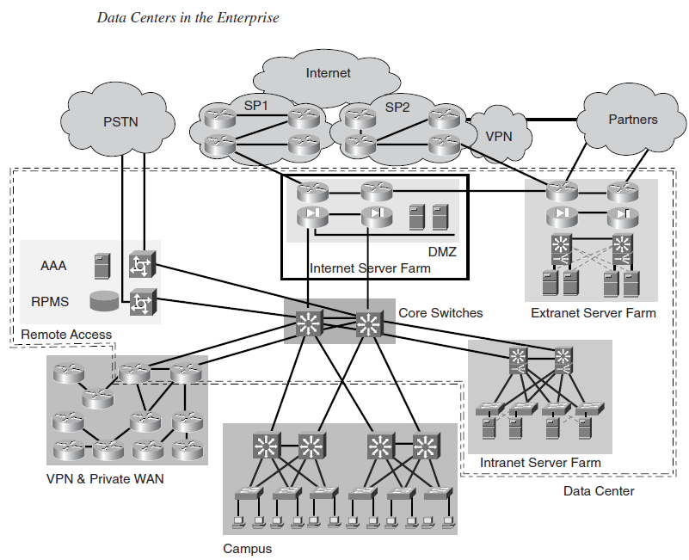
Introduction to Storage and Data Centers Information Storage
Notes:
The figure presents the different building blocks used in the typical enterprise network and illustrates the location of the Data Center within that architecture

Slide 62
Introduction to Storage and Data Centers Information Storage
Data Centers typically house many components that support the infrastructure building blocks, such as the core switches of the campus network or the edge routers of the private WAN.
Data Center designs can include any or all of the building blocks as shown in previous slide figure, including any or all server farm types. Each type of server farm can be a separate physical entity, depending on the business requirements of the enterprise.
Notes:
For example, a company might build a single Data Center and share all resources, such as servers, firewalls, routers, switches, and so on. Another company might require that the three server farms be physically separated with no shared equipment.

Slide 63
Introduction to Storage and Data Centers Information Storage
Role of Data Center in Service Provider Environment

Slide 64
Introduction to Storage and Data Centers Information Storage
Data Centers in service provider (SP) environments, known as Internet Data Centers (IDCs), unlike in enterprise environments, are the source of revenue that supports collocated server farms for enterprise customers.
The SP Data Center is a service-oriented environment built to house, or host, an enterprise customer’s application environment under tightly controlled SLAs for uptime and availability. Enterprises also build IDCs when the sole reason for the Data Center is to support Internet-facing applications.
Notes:
IDCs are separated from the SP internal Data Centers that support the internal business applications environments.
Whether built for internal facing or collocated applications, application environments follow specific application architectural models such as the classic client/server or the n-tier model.

Slide 65
Introduction to Storage and Data Centers Information Storage
Self Assessment Questions
10. Which of the following is a building block of a typical enterprise network?
Private WAN
Remote access
Extranet server farm
All of these
Answer: d)
Notes:
10. d)

Slide 66
Introduction to Storage and Data Centers Information Storage
11. IDCs are
Data centers in Enterprise environment
Data centers in Service Provider environment
Data centers in local environment
None of the Above
Answer: b)
Notes:
11. b)

Slide 67
Introduction to Storage and Data Centers Information Storage
Data Center Architecture

Slide 68
Introduction to Storage and Data Centers Information Storage
In this section, we shall discuss the architecture of a generic enterprise Data Center connected to the Internet and supporting an intranet server farm.
Notes:
Other types of server farms follow the same architecture used for intranet server farms yet with different scalability, security, and management requirements

Slide 69
Introduction to Storage and Data Centers Information Storage
Topology of an Enterprise Data Center Architecture

Slide 70
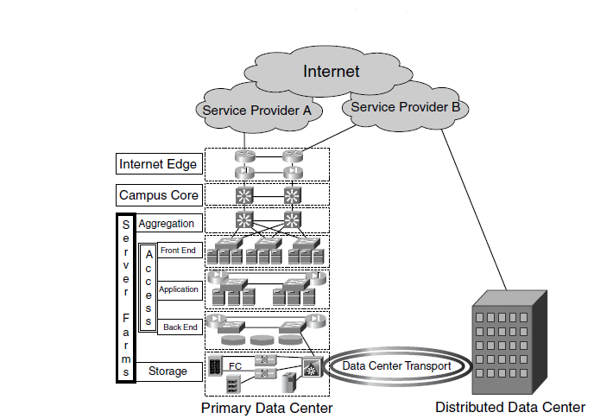
Introduction to Storage and Data Centers Information Storage
Notes:
The figure shows a fully redundant enterprise Data Center supporting the following areas:
No single-point of failure – redundant components
Redundant Data Centers
The core connectivity functions supported by Data Centers are Internet Edge connectivity, campus connectivity, and server-farm connectivity, as presented in this figure

Slide 71
Introduction to Storage and Data Centers Information Storage
Internet Edge
The Internet Edge provides the connectivity from the enterprise to the Internet and its associated redundancy and security functions, as following:
Redundant connections to different service providers
External and internal routing through exterior border gateway protocol (EBGP) and interior border gateway protocol (IBGP)
Edge security to control access from the Internet
Control for access to the Internet from the enterprise clients

Slide 72
Introduction to Storage and Data Centers Information Storage
Campus Core Switches
The campus core switches provide connectivity between the Internet Edge, the intranet server farms, the campus network, and the private WAN.
The core switches physically connect to the devices that provide access to other major network areas, such as the private WAN edge routers, the server-farm aggregation switches, and campus distribution switches.

Slide 73
Introduction to Storage and Data Centers Information Storage
Network Layers of the Server Farm
Aggregation Layer
Access Layer
Storage Layer
Data Center Transport Layer

Slide 74
Introduction to Storage and Data Centers Information Storage
Aggregation Layer
The aggregation layer is the aggregation point for devices that provide services to all server farms. These devices are multilayer switches, firewall, load balancers, and other devices that typically support services across all servers
.

Slide 75
Introduction to Storage and Data Centers Information Storage
Access Layer
The access layer provides Layer 2 connectivity and Layer 2 features to the server farm. In a multitier server farm, each server function could be located on different access switches on different segments. The three segments are: Front End segment, Application segment and Back End segment.

Slide 76
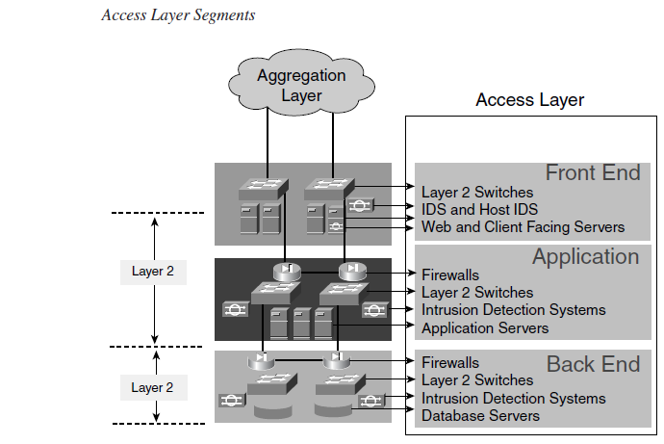
Introduction to Storage and Data Centers Information Storage

Slide 77
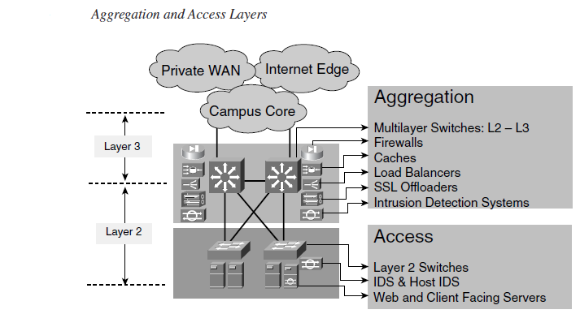
Introduction to Storage and Data Centers Information Storage
Aggregation and Access Layers
Notes:
As shown in Figure, the aggregation switches provide basic infrastructure services and connectivity for other service devices.

Slide 78
Introduction to Storage and Data Centers Information Storage
Storage Layer
The storage layer consists of the storage infrastructure such as Fibre Channel switches and routers that support small computer system interface (SCSI) over IP (iSCSI) or Fibre Channel over IP (FCIP). Storage network devices provide the connectivity to servers, storage devices such as disk subsystems, and tape subsystems.

Slide 79
Introduction to Storage and Data Centers Information Storage
Transport Layer
The Data Center transport layer includes the transport technologies required for the following purposes:
Communication between distributed Data Centers for rerouting client-to-server traffic
Communication between distributed server farms located in distributed Data Centers for the purpose of remote mirroring, replication, or clustering
Notes:
Transport technologies must support a wide range of requirements for bandwidth and latency depending on the traffic profiles, which imply a number of media types ranging from Ethernet to Fibre Channel.

Slide 80
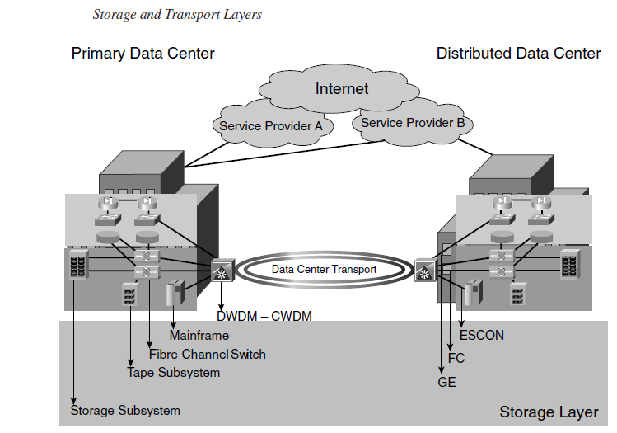
Introduction to Storage and Data Centers Information Storage
Storage and Transport Layers

Slide 81
Introduction to Storage and Data Centers Information Storage
Self Assessment Questions
12. ________________ provides the connectivity from the enterprise to the Internet.
Internet Edge
Campus Core Switches
Access layer
Storage layer
Answer: a)
Notes:
12. a)

Slide 82
Introduction to Storage and Data Centers Information Storage
The ________________ provide connectivity between the Internet Edge, the intranet server farms, the campus network, and the private WAN.
Internet Edge
Campus Core Switches
Access layer
Storage layer
Answer: b)
Notes:
13. b)

Slide 83
Introduction to Storage and Data Centers Information Storage
14. Access layer provides Layer 2 connectivity and Layer 2 features to the server farm.
True
False
Answer: a)
Notes:
14. a)

Slide 84
Introduction to Storage and Data Centers Information Storage
Document Links
Topics | URL | Notes
Data Center Architecture | https://www.fiberoptics4sale.com/blogs/archive-posts/95041990-what-are-data-centers | This link explains about the detailed architecture of data center, in particular enterprise data center
Data Center Strategy | http://focus.forsythe.com/articles/396/10-Steps-to-a-Successful-Data-Center-Strategy | This link explains the steps to a successful Data Center strategy

Slide 85
Introduction to Storage and Data Centers Information Storage
Video Links
Topics | URL | Notes
Data Center Deployment | https://www.youtube.com/watch?v=McVZ01kn-lQ | This video explains about real ife data center deployment and best practices
Data Center Topology | https://www.youtube.com/watch?v=8M0XPOiKC7I | In this Video, you will learn about details of Data Center topology

Slide 86
Introduction to Storage and Data Centers Information Storage
Self Assessment Questions
15. In data center environment, cooling is required because
Workers may feel hot
Workers can work comfortably
Equipments emit excessive heat
None of these
Answer: c)
Notes:
15. c)

Slide 87
Introduction to Storage and Data Centers Information Storage
16. Accessibility of data center elements will have no impact on business.
True
False
Answer: b)
Notes:
16. b)

Slide 88
Introduction to Storage and Data Centers Information Storage
17. Good location of data center indicates ____________________________
Continuous service availability
No impact on service
Better service quality
None of these
Answer: a)
Notes:
17. a)

Slide 89
Introduction to Storage and Data Centers Information Storage
18. Uptime indicates ______________________
Time in which all services are up and running
Time in maintenance operation of the data center
Time in which some services are temporarily suspended
None of these
Answer: a)
Notes:
18. a)

Slide 90
Introduction to Storage and Data Centers Information Storage
19. Powerful backup solution guarantees ________ uptime
Low
Medium
High
None of these
Answer: c)
Notes:
19. c)

Slide 91
Introduction to Storage and Data Centers Information Storage
20. The term _____________ indicates additional on-demand capabilities.
Robustness
Scalability
Accessibility
Fault tolerance
Answer: b)
Notes:
20. b)

Slide 92
Introduction to Storage and Data Centers Information Storage
21. Which of these is true about change management?
No unplanned alteration in the data center
Enforces changes in data center from time to time
Manage various changes that take place in data center
None of the above
Answer: a)
Notes:
21. a)

Slide 93
Introduction to Storage and Data Centers Information Storage
It is important to have a Plan B in place in a typical data center environment. State whether True or False.
True
False
Answer: a)
Notes:
22. a)

Slide 94
Introduction to Storage and Data Centers Information Storage
In a multitier server farm, each server function could be located on different access switches on different segments. State true of false.
True
False
Answer: a)
Notes:
23. a)

Slide 95
Introduction to Storage and Data Centers Information Storage
24. Which of these is not a segment of Access Layer?
Front end segment
Back end segment
Application segment
Middle level segment
Answer: d)
Notes:
24. d)

Slide 96
Introduction to Storage and Data Centers Information Storage
Summary
Data is a collection of raw facts from which the required output is extracted.
Information is processed data. The value of information changes over time.
Storage technology has evolved through configurations such as RAID, DAS, SAN, NAS, and IP-SAN.
The change in value of information with the change in time is called information lifecycle.
ILM is a comprehensive approach in managing the flow of data from its creation to its disposal.
The key requirement for data center, elements are availability, location and facility, uptime, cooling, security, facility maintenance, scalability, and change management.

Slide 97
Introduction to Storage and Data Centers Information Storage
Assignment
You need to answer below sets of problem. These sets of questions are meant for testing unit I.
Define data and information with real life examples.
Explain in your own words, how structured and unstructured data differs?
Write a description on evolution of storage technologies.
Explain the different stages of Information Lifecycle.
What is ILM ? Explain the various ILM benefits.
Why do we need data centers? Explain.
Name and explain the core elements in data center infrastructure.
Explain the architecture of Enterprise Data Center.

Slide 98
Introduction to Storage and Data Centers Information Storage
Document Links
Topics | URL | Notes
Cover Story: Storage Management | http://www.networkmagazineindia.com/200309/coverstory01.shtml | This link explains a general overview of storage management, along with expert’s opinion
Storage infrastructure management is still elusive | http://searchstorage.techtarget.com/opinion/Storage-infrastructure-management-is-still-elusive | You will learn Basic challenges associated with Storage and its management
Steps to ILM implementation | http://www.networkworld.com/article/2300188/data-center/six-steps-to-ilm-implementation.html | This link explains about the six steps to successfully implement ILM
Information Lifecycle Management | http://searchstorage.techtarget.com/definition/information-life-cycle-management | This link explains about ILM approach in industry
Data Center Architecture | https://www.fiberoptics4sale.com/blogs/archive-posts/95041990-what-are-data-centers | This link explains about architecture of data center , with emphasis to enterprise and discussing each component in details
Data Center Strategy | http://focus.forsythe.com/articles/396/10-Steps-to-a-Successful-Data-Center-Strategy | In this link, you will learn about the steps for adopting a successful Data Center Strategy

Slide 99
Introduction to Storage and Data Centers Information Storage
Video Links
Topics | URL | Notes
Types of storage technologies | https://www.youtube.com/watch?v=bpUzGZLO948&list=PLWDUzz3hCDJJFiOO_zpMTbiHUNPDpU3xb | This link compares DAS, NAS and SAN technologies
Overview of data and information | https://www.youtube.com/watch?v=mUgEgkV16Bw | This link explains what is data and information. A short description on how data differs from information.
Inside a Google Data Center | https://www.youtube.com/watch?v=XZmGGAbHqa0 | This link takes us to a virtual tour inside a Google Data Center

Slide 100
Introduction to Storage and Data Centers Information Storage
E-Book Links
Topics | URL | Page Number
Building a Modern Data Center | https://www.actualtechmedia.com/wp-content/uploads/2016/05/Building-a-Modern-Data-Center-ebook.pdf | Page Number 14 to Page Number 22
Information Storage and Management | http://www.academia.edu/19388733/1_1_Information_Storage_and_Management_2nd_Edition | Page Number 4 - Page Number 15

